Slide 1
Building APIs in Government for Social Good
Tyrone Grandison PhD
www.tyronegrandison.org @tyrgr
Notes:
By show of hands,
How many people here have worked in Government?
How many people think that there is a technical difference between delivering APIs in Government vs the Private Sector?
My mission here today to shed some light on the process.
If there is anything that you need to remember from this talk, it is that there are more similarities than differences.

Slide 2
Deputy Chief Data Officer, US Department of Commerce (2015-16) White House Presidential Innovation Fellow, Department of Labor & US Census Bureau (2014-15)
My Time In Government
Notes:
I have spent the last two and a half years of my life working in government.

Slide 3

Notes:
Before government, I worked in the private sector, academia and startup world as a developer (Python, Java, C, C++), manager, CTO, Consultant and Founder, which gives me a unique perspective.

Slide 4
The Reality
APIs: Sweat and Toil, CitySDK, MIDAAS
Lessons
Notes:
This is the plan for today.
I am going to start with the reality of government, delve in three APIs that my teams and I have built, and finish with the lessons that we have learned.

Slide 5
government takes on the hardest, inelastic problems
Notes:
While the private sector takes on elastic problems, like entertainment and marketing.
Government takes on hard problems like homelessness, health, safety, defense, trade, and social justice.

Slide 6
optimum
Notes:
The problems are difficult optimization problems
And not just in one dimension.

Slide 7
n-dimensional
Notes:
But rather in multiple dimensions
And many of the dimensions are not anywhere technology or science related.
*** Laws, Systems, Personalities/Egos.

Slide 8
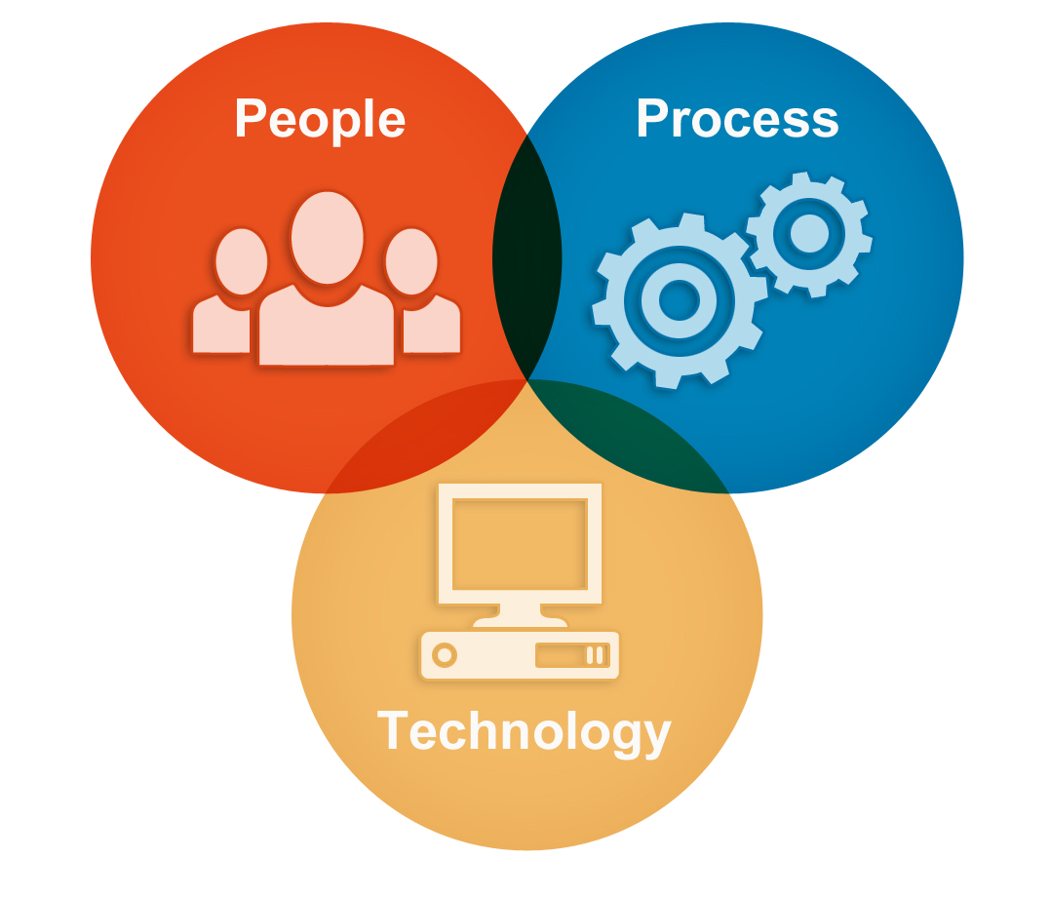
Notes:
Developing APIs (or any tech) in Government is an issue in Organizational Change Management.
Where you have align Process, Policy and People in order to enable Technology development.
It is daunting, slow and normally takes a lot of time.

Slide 9

Notes:
However, there is hope on the horizon.

Slide 10
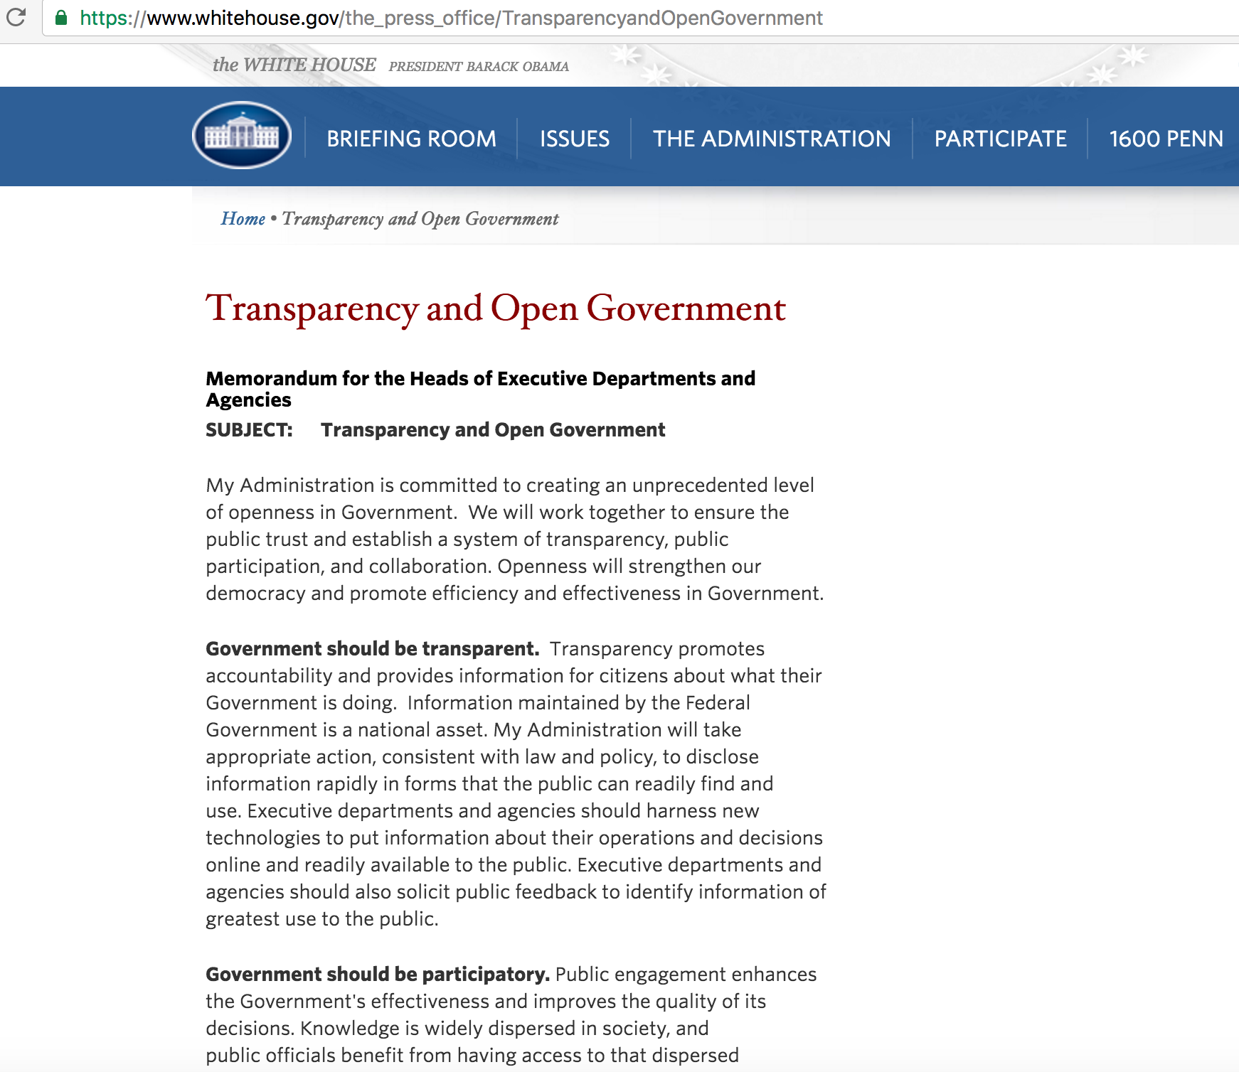
Executive Order M-13-13
Notes:
On May 9th 2013, the President created an Executive Order that stated that data produced by the US government should be machine-readable and open by default.
Executive Order -- Making Open and Machine Readable the New Default for Government Information

Slide 11
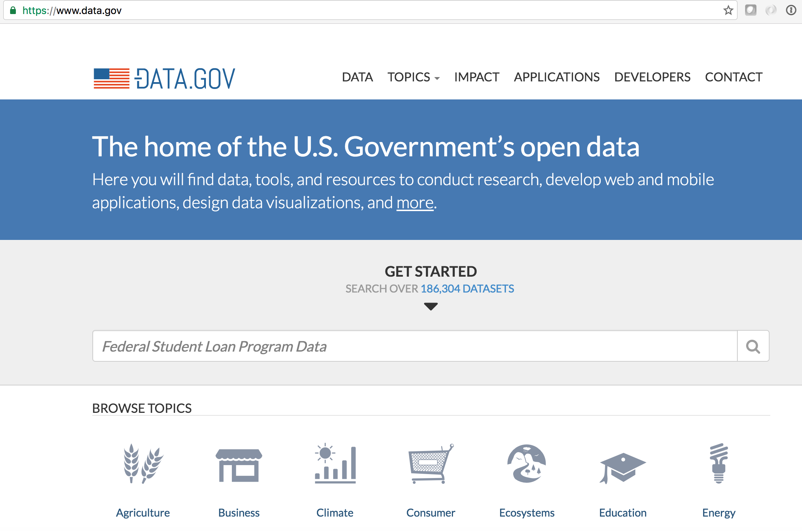
Notes:
Data.gov, which was launched in May 2009, was used as the vehicle or mechanism to fuel compliance to M-13-13 and offer a wealth of new data sets and APIs to the community.

Slide 12
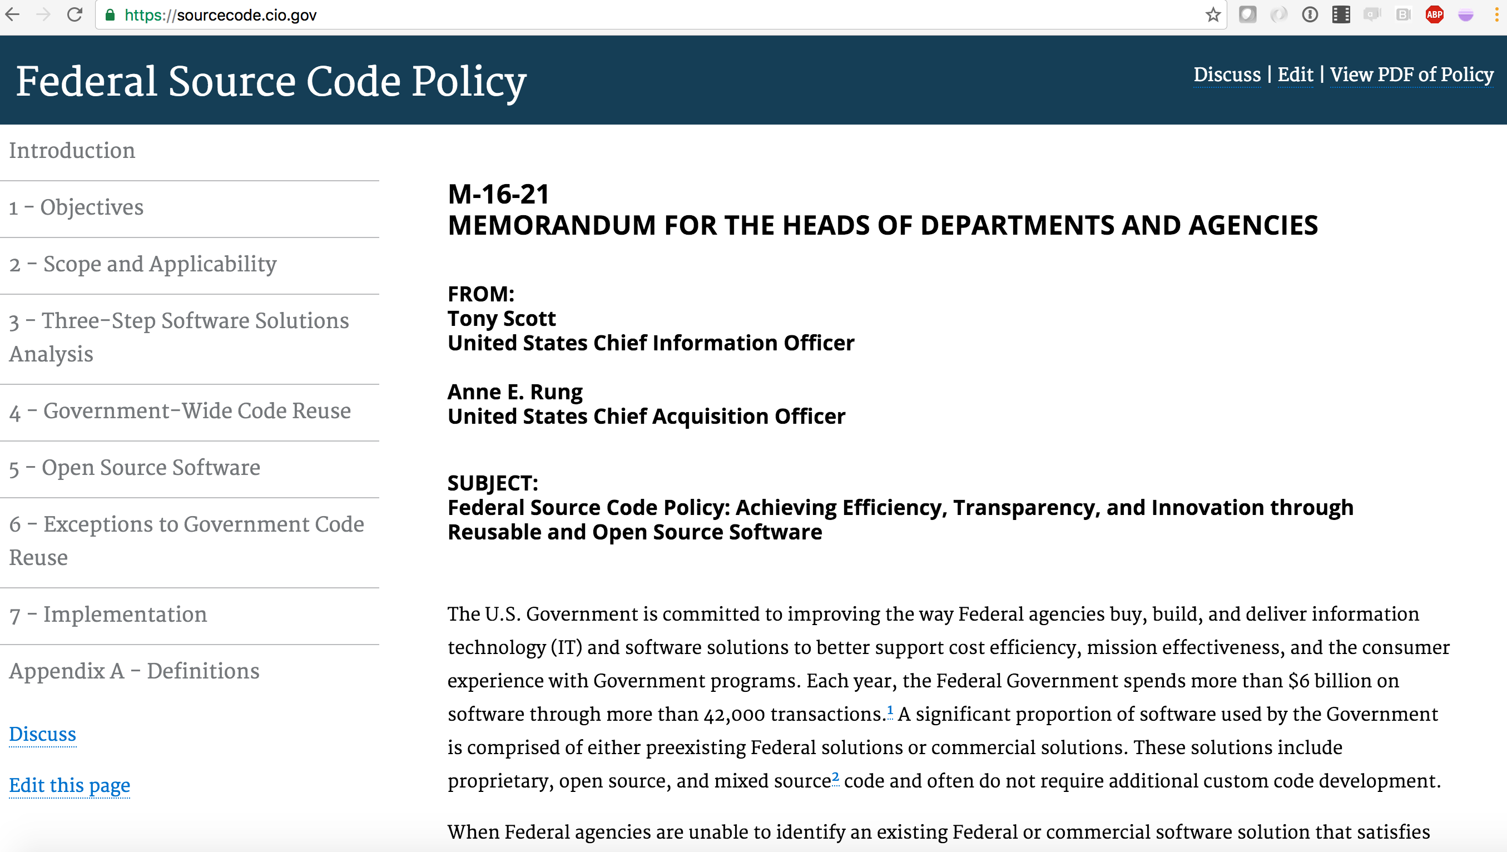
Notes:
Additionally, the Administration has just released the initial guidelines on Federal Source Code.

Slide 13

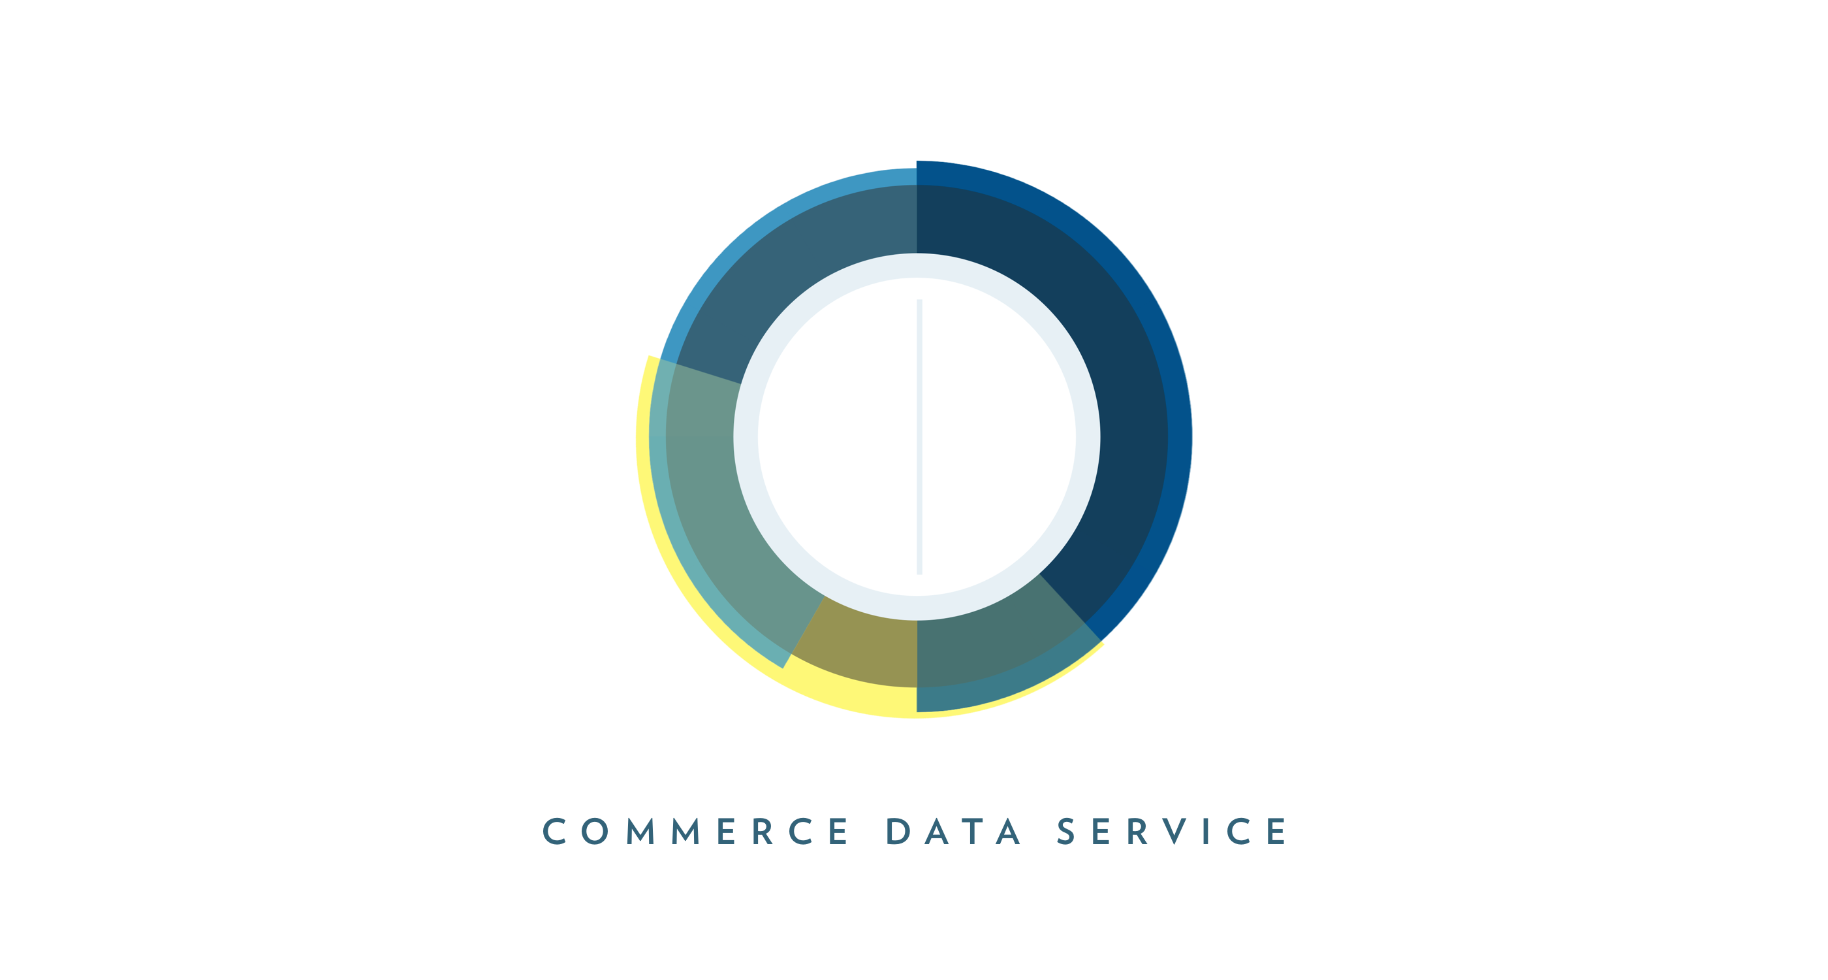


Notes:
You throw into the mix, an amazing set of agile and user-centered startup-like organizations within government working on accelerating the development of data products and services, and you see why there has been a steady stream of Social Good APIs coming from the Federal government over the last few years.

Slide 14
The Reality
APIs: Sweat and Toil, CitySDK, MIDAAS
Lessons
Notes:
Now, look at three APIs, focused on solving social problems, that my teams and I have developed and deployed within the last 15 months.

Slide 15
Sweat and Toil http://developer.dol.gov/others/sweat-and-toil https://github.com/USDepartmentofLabor/Child-Labor https://github.com/USDepartmentofLabor/Child-Labor-Android
Notes:
The first is Sweat and Toil. The API details are at the URL onscreen. The API fuels both Android and iPhone apps with the same name.
The data itself is the information produced by the Bureau of International Labor Affairs (ILAB) on the countries that produce goods and products that use child and or forced labor.
ILAB’s mission is to use all available international channels to improve working conditions, raise living standards, protect workers' ability to exercise their rights, and address the workplace exploitation of children and other vulnerable populations.

Slide 16

Notes:
Every year, ILAB has a congressional mandate to produce three reports on international child labor and forced labor.
Before our interaction with them, they spent nine months collecting information on all the countries in the world (except the US) to create over 1,000 pages of information that they then hand out in thick books; offering a PDF version on their website for increased accessibility.
Our idea was simple – liberate the data, make it available to the entire dev community and see what new and interesting things are done.

Slide 17

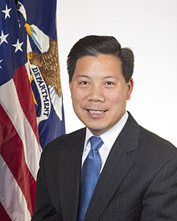
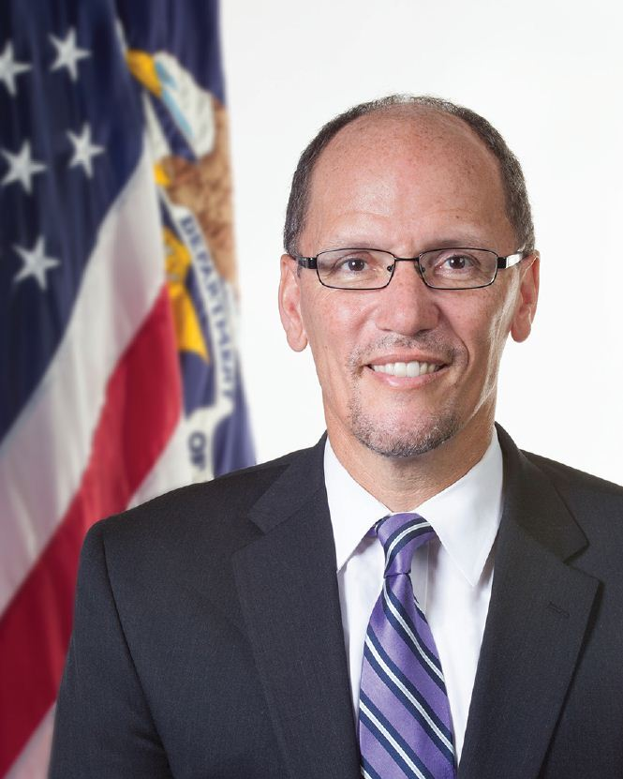
Building the API – Step 1
Coalition and Urgency
Notes:
Carol Pier

Slide 18
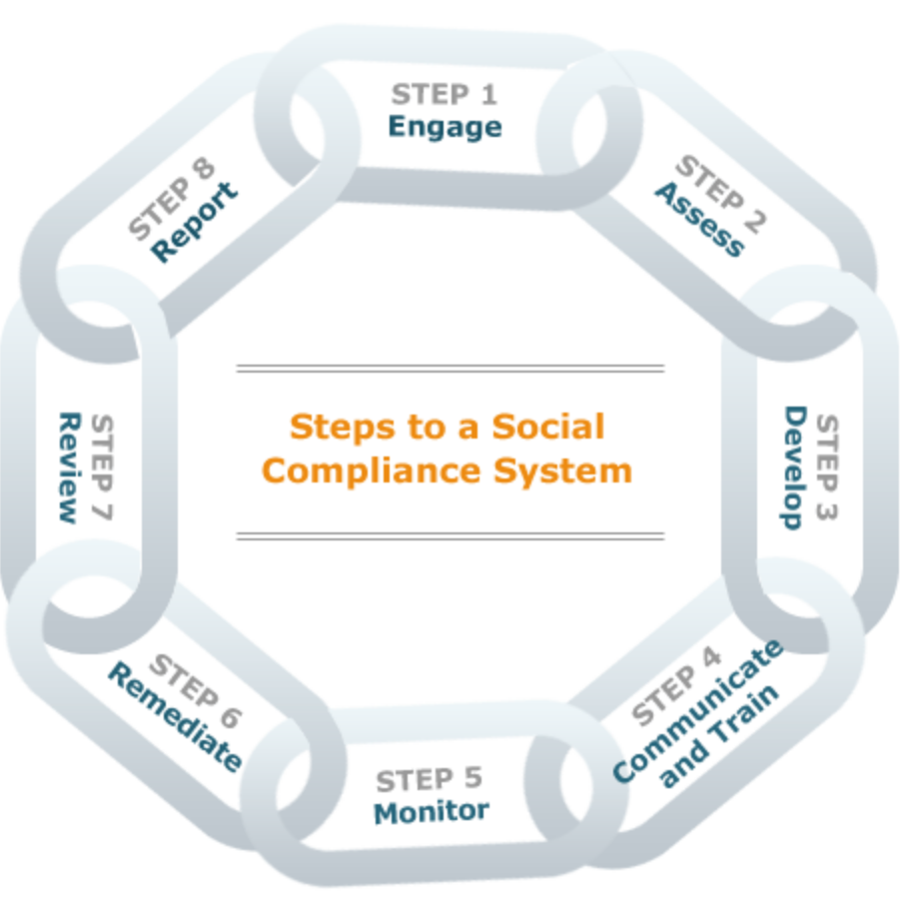
Building the API – Step 2
Understand The Data Production Process

Slide 19

Building the API – Step 3
Find Natural Intervention Point

Slide 20
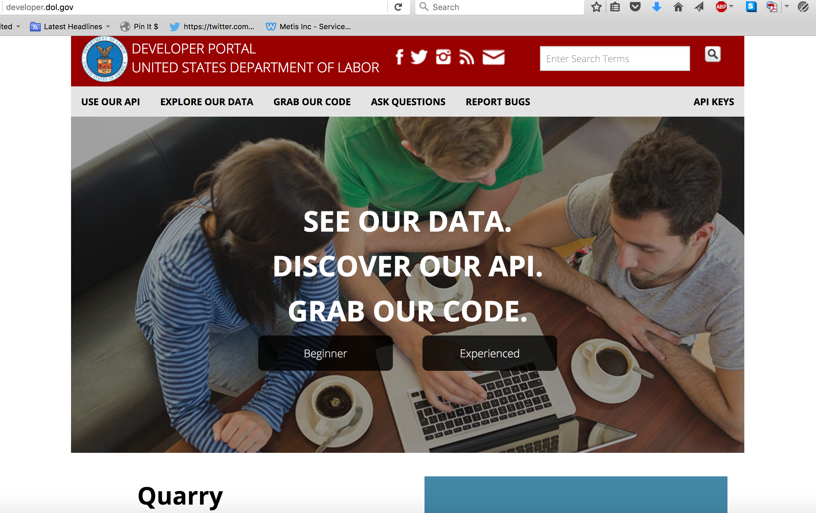
Building the API – Step 4
Learn Technology Constraints

Slide 21

Building the API – Step 5
Understand The API User Groups

Slide 22
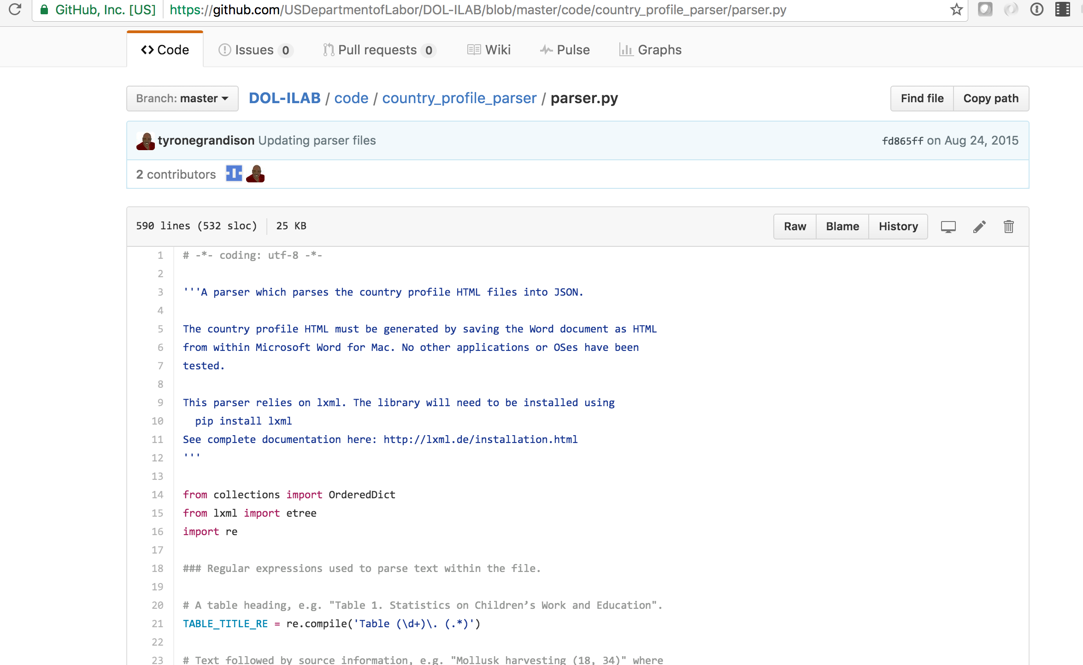
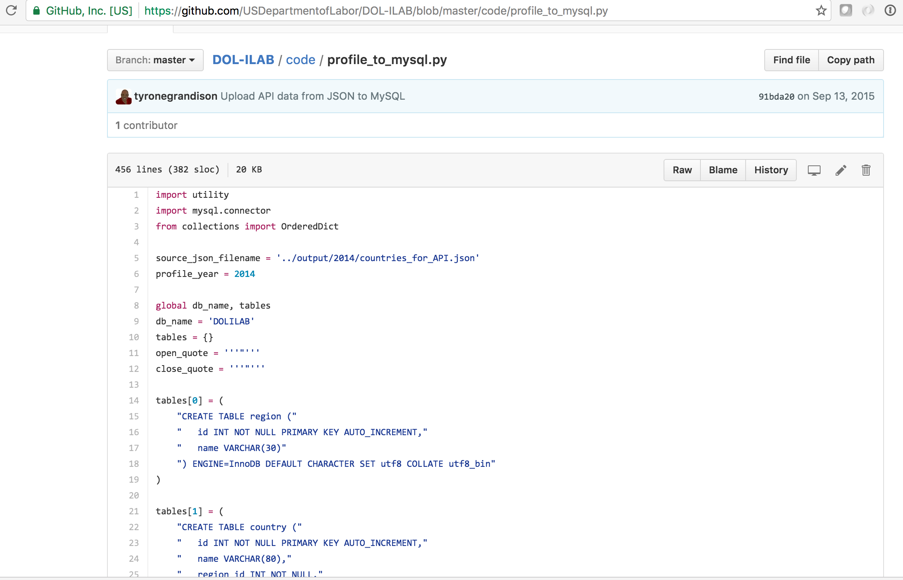
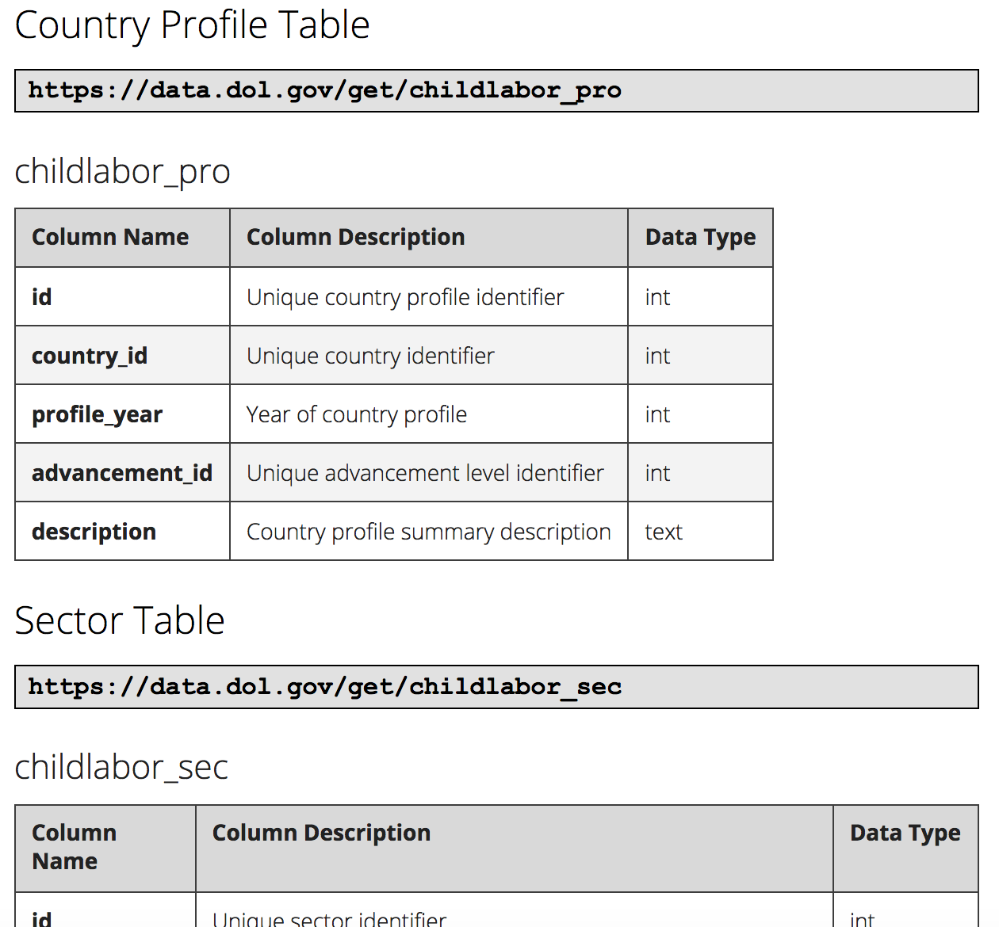
Building the API – Step 6
Python
MySQL, MSSQL
Quarry
Notes:
Quarry – PHP, CodeIgniter,

Slide 23
Census CitySDK https://uscensusbureau.github.io/citysdk/ https://github.com/uscensusbureau/citysdk

Slide 24
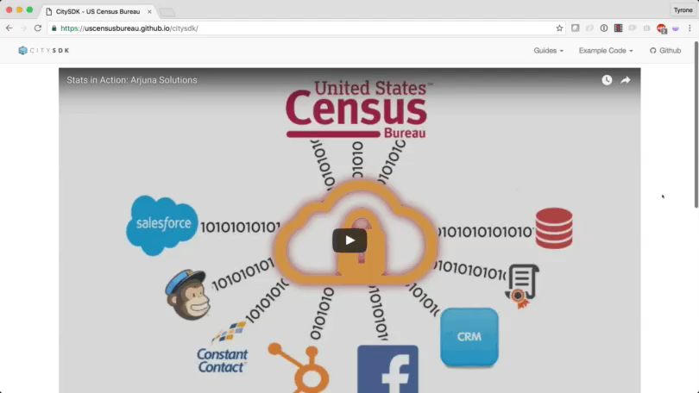

Slide 25
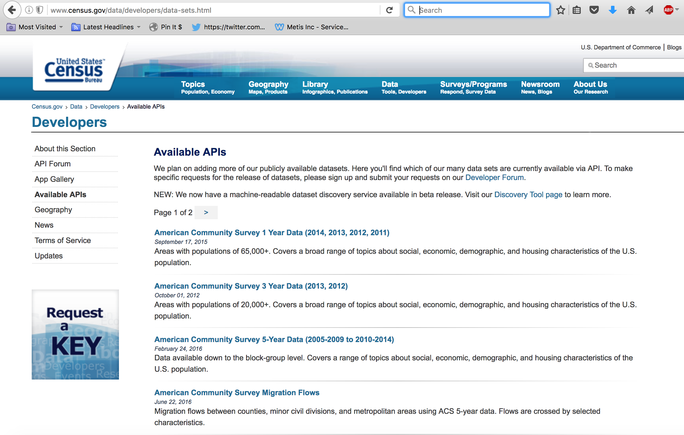
Building the API – Step 1
Validate The Demand

Slide 26
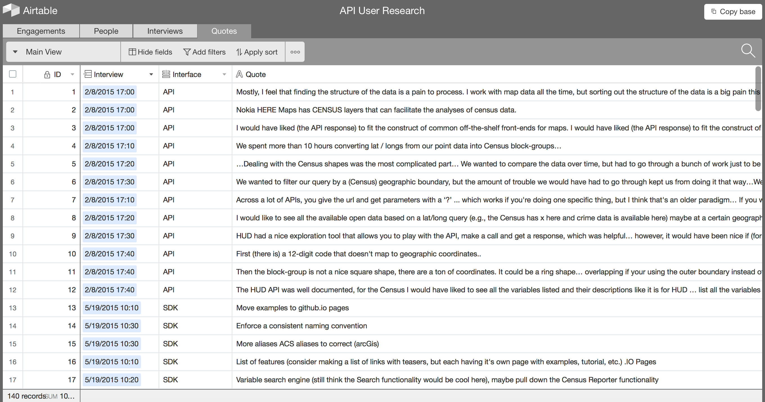
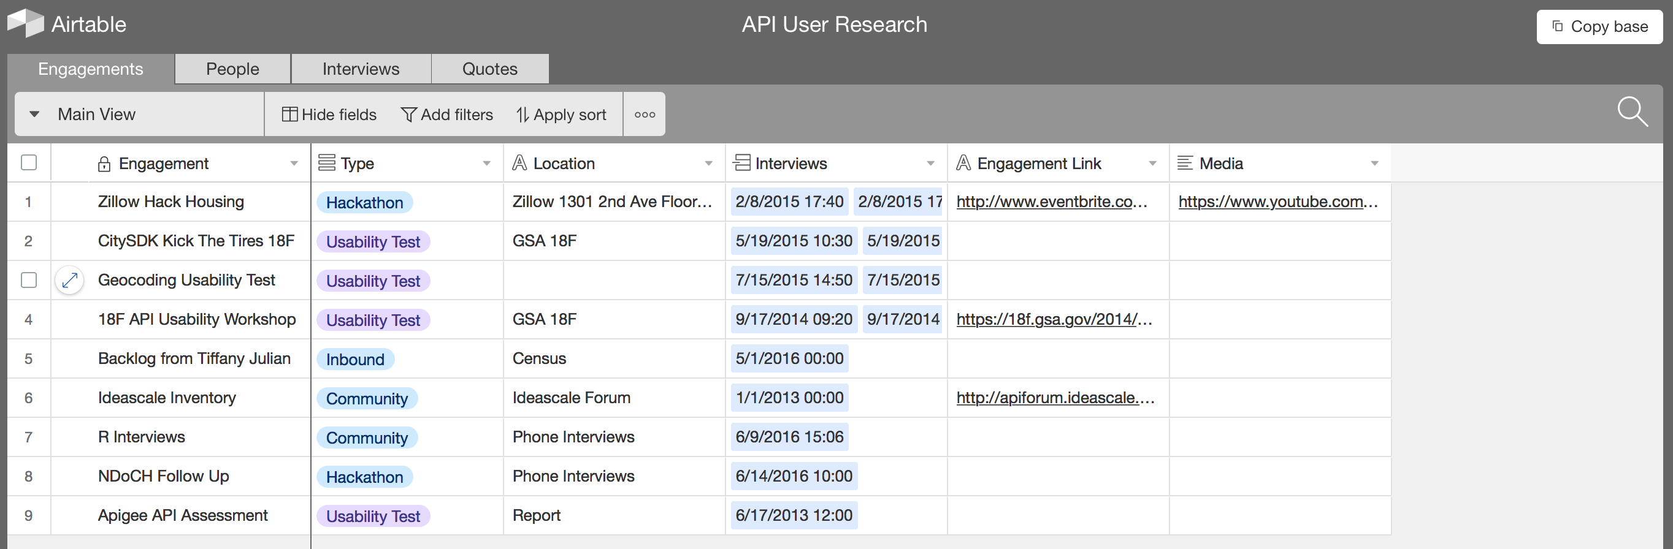
Building the API – Step 2
Understand The User

Slide 27
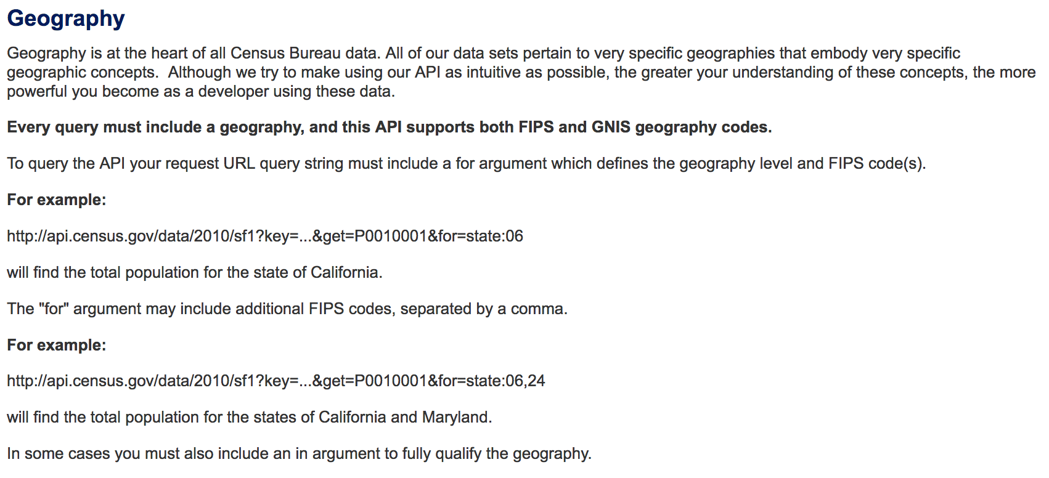
Building the API – Step 3
Understand Technology Constraints

Slide 28
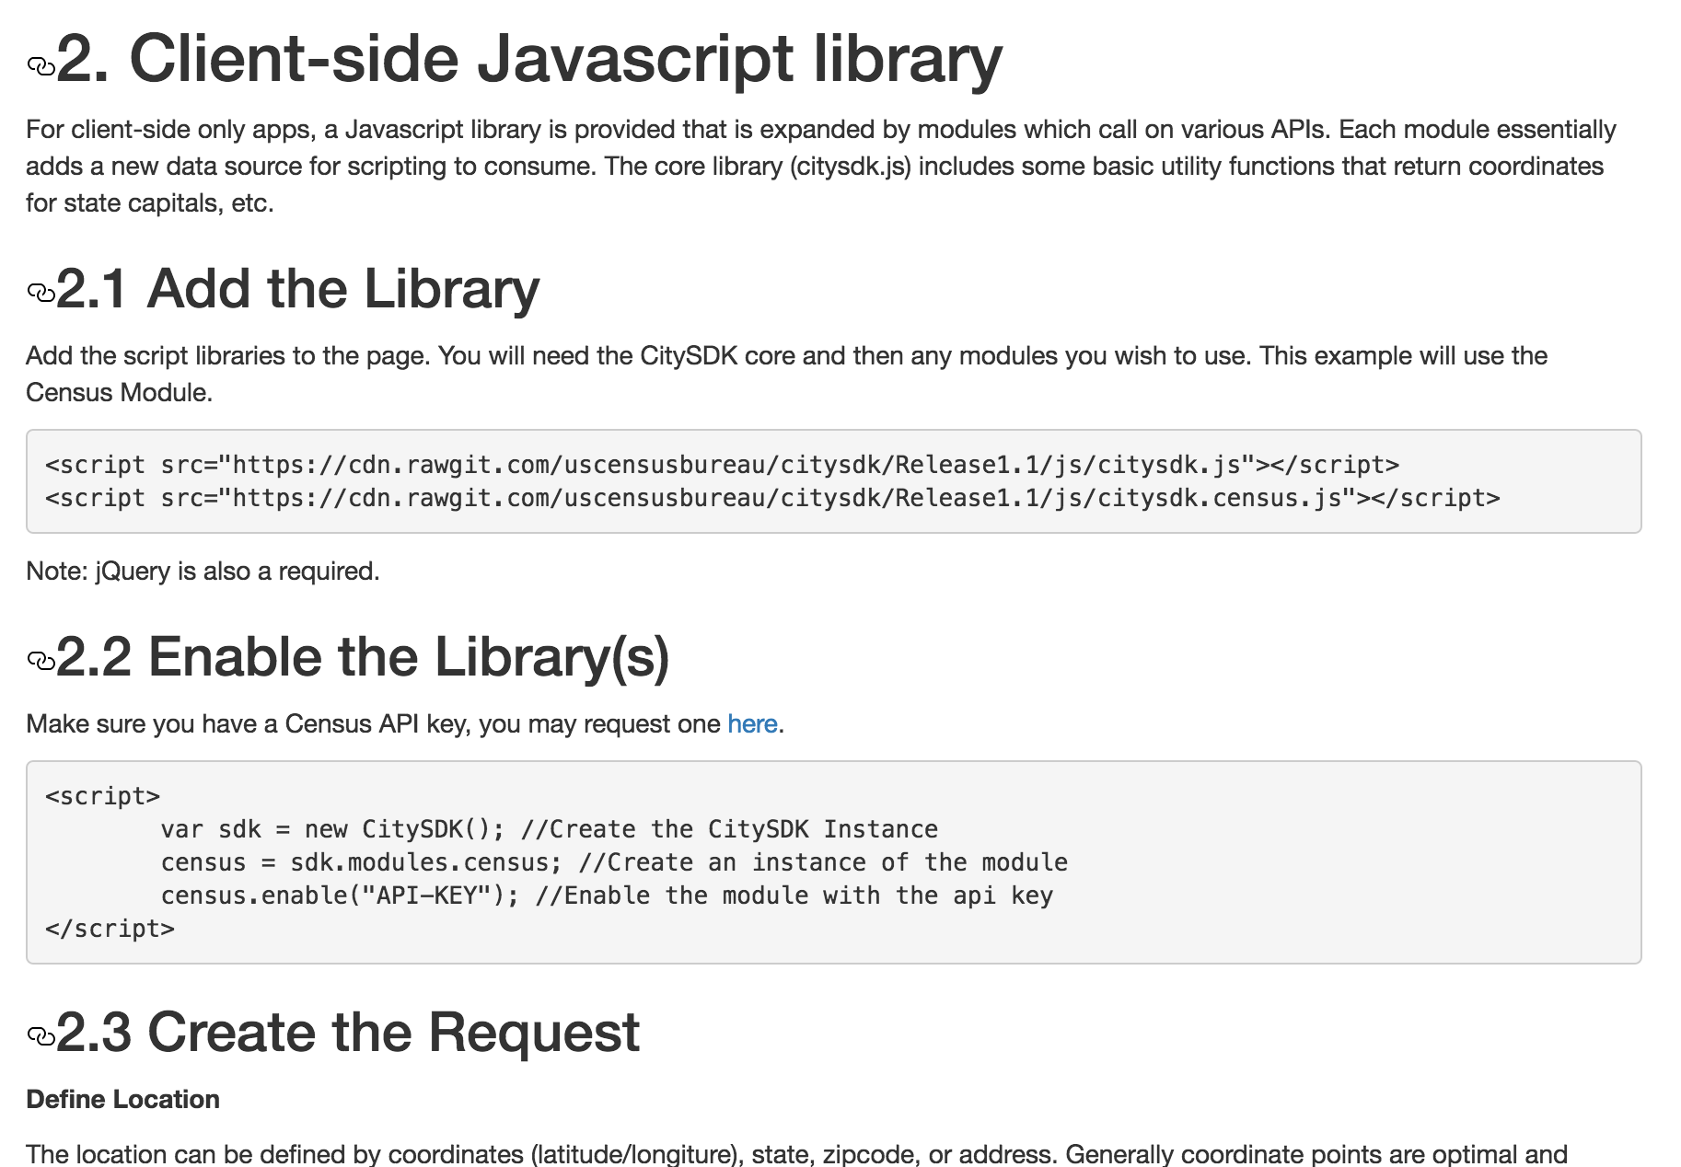
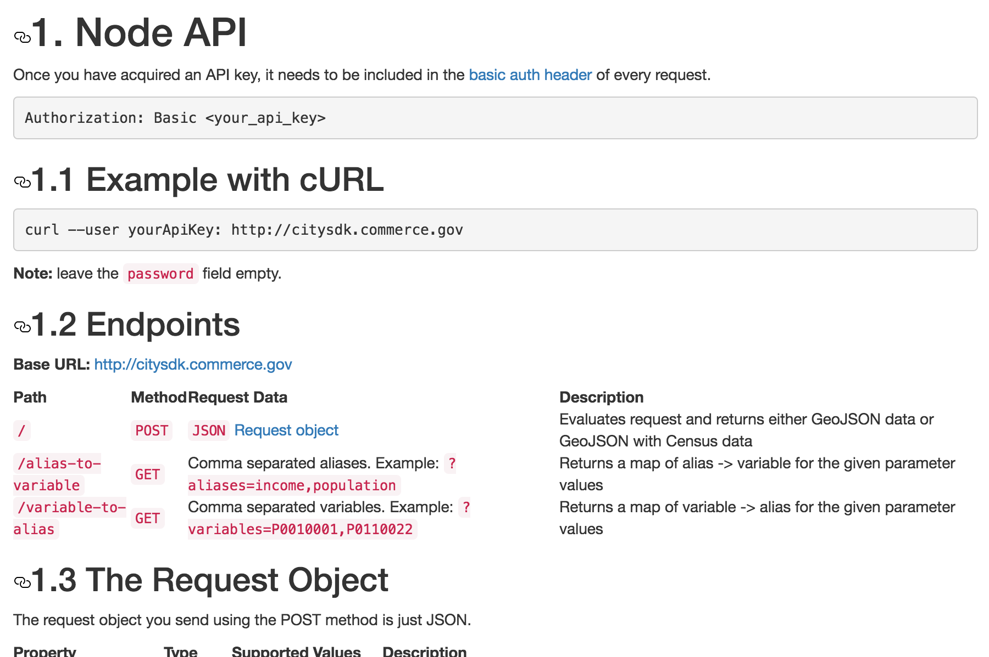
Building The API – Step 4
MVP
JS
beta
node.js

Slide 29
MIDAAS https://midaas.commerce.gov https://github.com/CommerceDataService/midaas-api

Slide 30
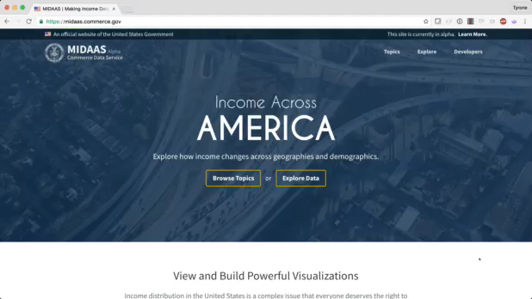

Slide 31
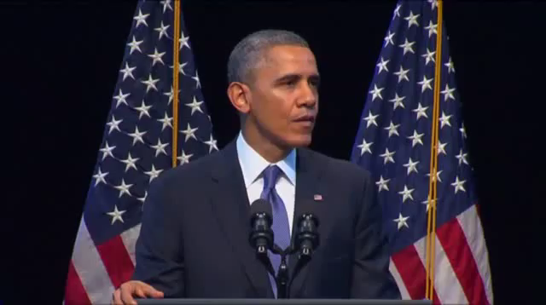
Building the API – Step 1
Validate The Need

Slide 32

Building the API – Step 2
Understand Initial User Stories

Slide 33
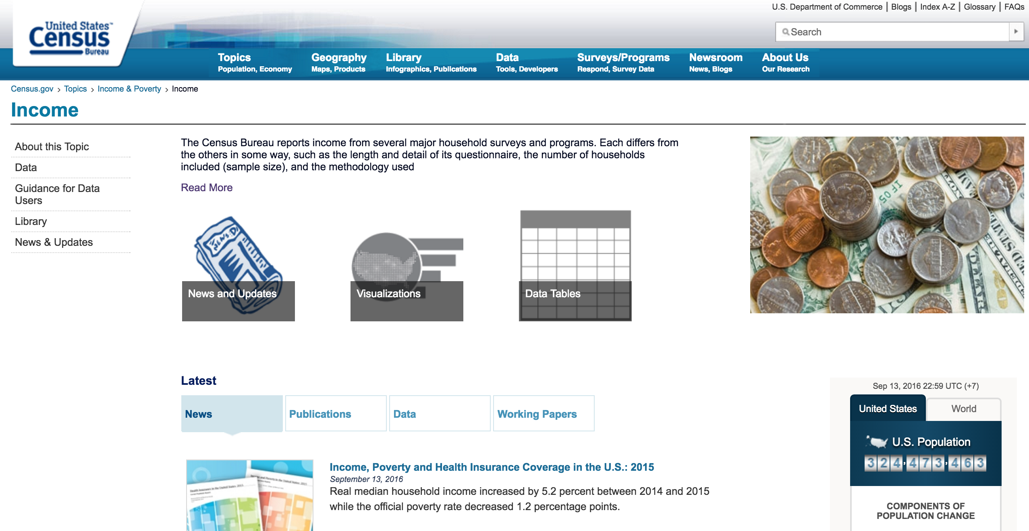
Building the API – Step 3
Validate with Domain Experts

Slide 34
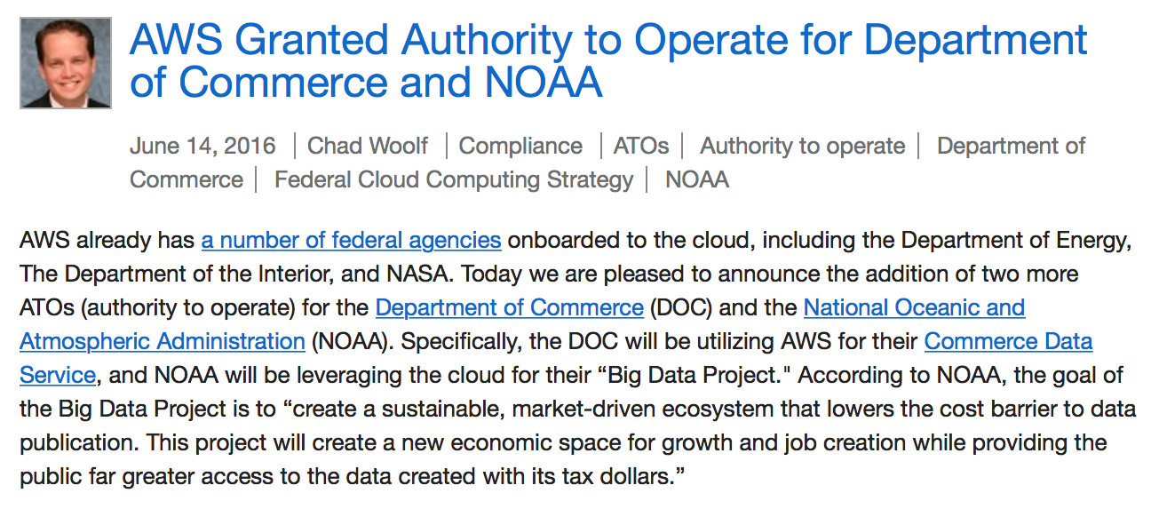
Building the API – Step 4
Understand Technical Constraints

Slide 35
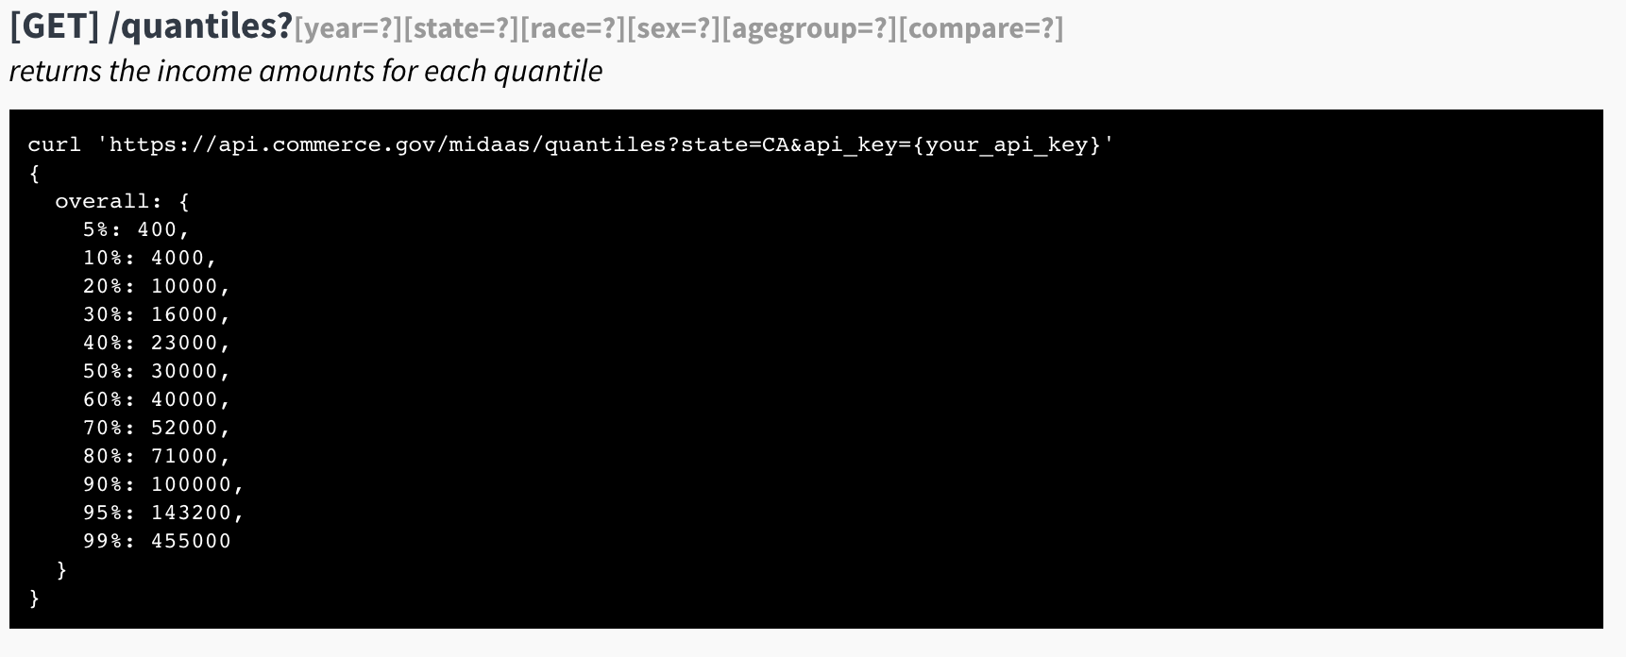
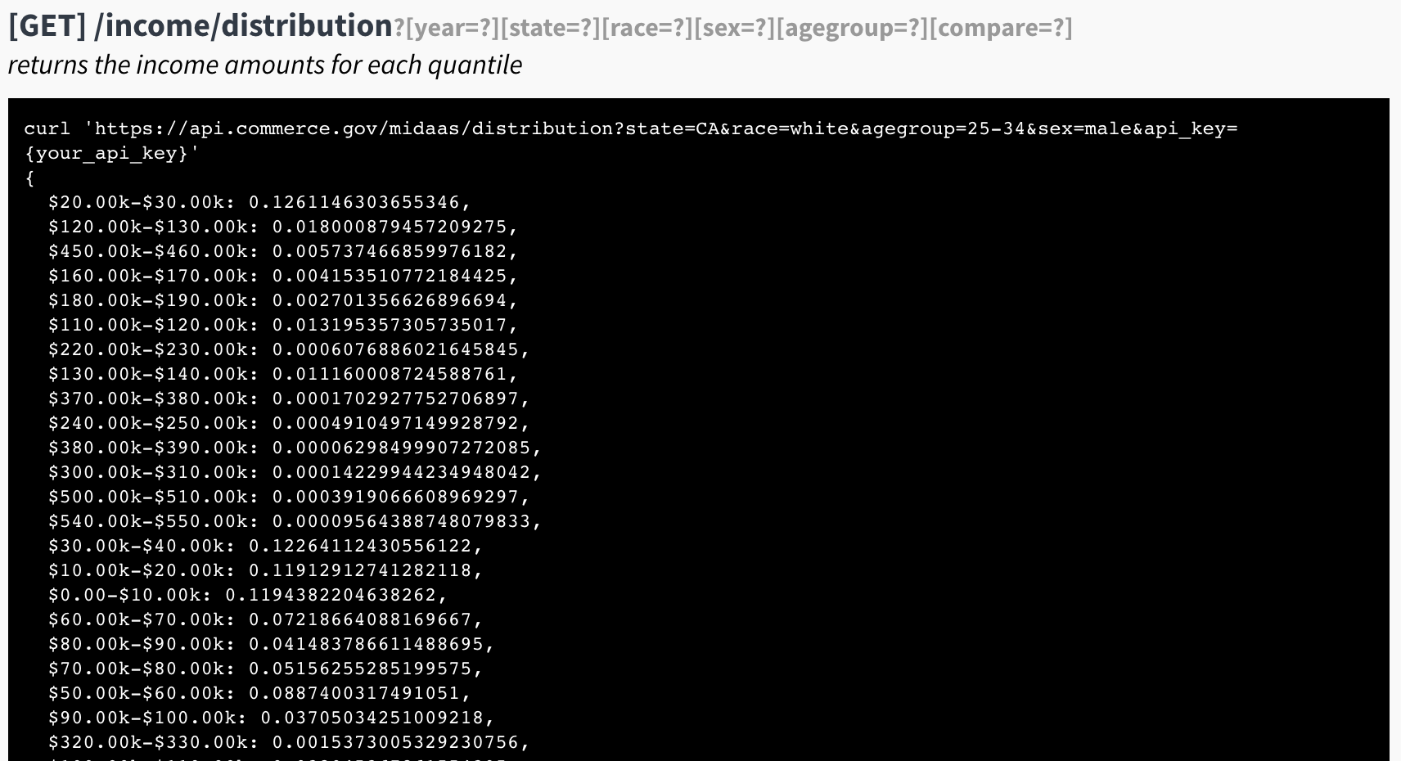
Building the API – Step 5
MVP
Redshift, Lambda, API Gateway
beta
Postgres, S3, EC2

Slide 36
The Reality
APIs: Sweat and Toil, CitySDK, MIDAAS
Lessons

Slide 37
Summary
People
Scope
Constraints
Validate
Show The Thing

Slide 38
So Far
Sweat and Toil
Monthly Data Users > Web Traffic
Three tools built using this data.
CENSUS CitySDK
Over 10 civic solutions built using CitySDK
Positive User Feedback

Slide 39
So Far
Sweat and Toil
2016 Department of Labor‘s Innovation Award.
CENSUS CitySDK
2016 Department of Commerce Gold medal
2016 Best Data API Award, API:World
2015 Fedscoop Innovation Of The Year

Slide 40
Thank you
tyronewagrandison@gmail.com

